Slide 1

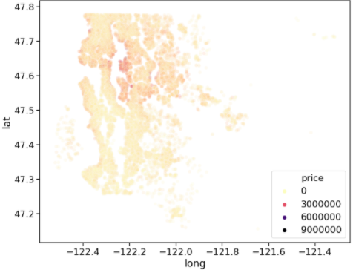
Kings County house price EDA and testing
This Photo by Unknown Author is licensed under CC BY-NC

Slide 2
Content
Overview
Initial Hypothesis Summary
Dataset and feature description
Data validation and outlier check
Univariate Analysis
Inference from Univariate Analysis
Bi-Variate Analysis
Hypothesis Testing
Inference from Bivariate Analysis
Mean Model
Outcome from our analysis

Slide 3
Overview
A real estate agency wanted to reduce the negotiation time and improve closure for buyers and sellers of homes by ensuring that both sides were advised well on the potential sale/purchase price of the home. To that end the agency wanted to predict a transaction price for all the houses in its market which would be as close as possible to a price where the transaction would take place.
Our aim in this presentation is to summarize our analysis and try to present most important points from our notebook. In the process, we had to scrutinize several inferences we made during working on the dataset.

Slide 4
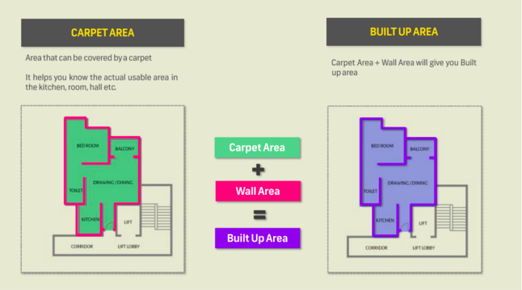
From our initial hypothesis, we were able to deduce below formula for factors that can impact house prices:
House price = Area(Carpet area + built up area+ other factors) * Rate (Feature + Facilities available + other -factors)
By above formula it can be concluded that change
in any/both of factor (area , rate ) can lead to change
in house price.

Slide 5
Some initial hypothesis we made were:
Area Affecting Fact0ors --
Build-up area (More) would increase prices
Carpet area (more) increases house prices.
More rooms results in high house price.
(Changes in)Basement Area may not have much difference on prices.

Slide 6
Rate Affecting factors –
New houses wrt Age and Less Renovation gap might have more prices
Sea-facing houses leads in more prices
Houses in excellent conditions would more price than houses.
Better Graded House are expensive.
Houses in rural area have more prices compared to houses in urban area

Slide 7
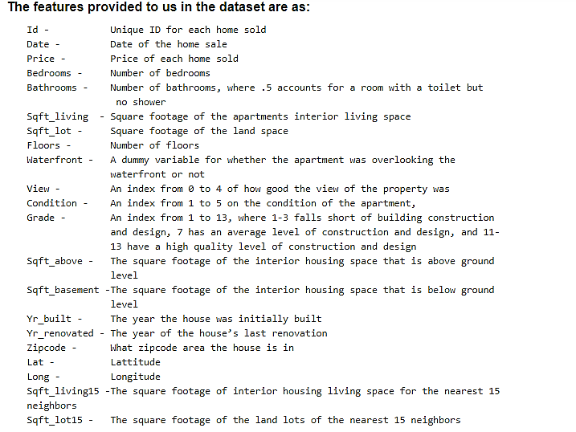
KC Housing Price dataset

Slide 8
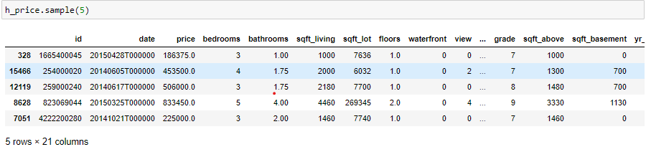
Sample from the dataset
Sharing a sample from the provided dataset:
We have dataset with 21613 rows and 21 columns.

Slide 9
Data validation:
We performed few checks on the dataset to find and fix any anomalies in the loaded dataset.
No. of Null values in the dataset – Zero
Column datatype – some datatypes are not correctly identified and we need to change their datatype.
Changed date feature to Datetime.
Created two separate columns holding year and month of the house sold date.
Changed few features as - “grade”, ”condition”, ”waterfront”, ”view” to category datatype.
Created a separate column holding “age” of the house from feature “yr_built”.

Slide 10

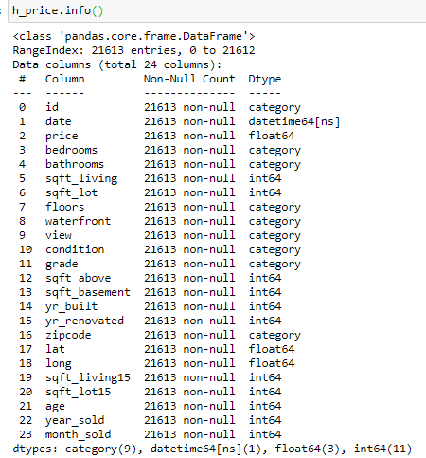
Datatype of all columns

Slide 11
Univariate Analysis
Let’s divide our features into two parts:
Continuous (Numerical)
Categorical
While working with features, we plotted graphs to help us visualize the distribution of data.
Under Continuous features, we worked onto each feature to derive basic details as:
Data spread
Outliers
Similarly, under categorical features, we checked for:
Number of categories
Data distribution
Outliers

Slide 12
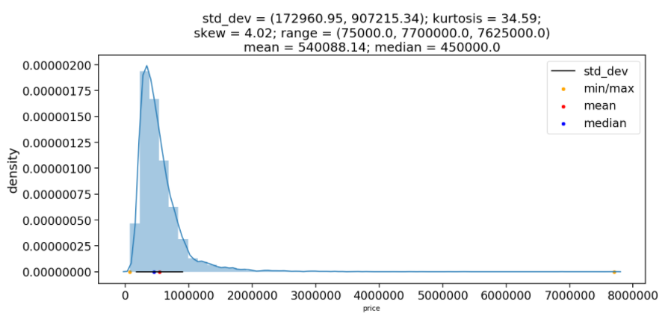
Observations about Target Variable “price”.
Minimum price – 75,000 ; Maximum price – 7,700,000
Right Skewed .
Leptokurtic
increase in

Slide 13
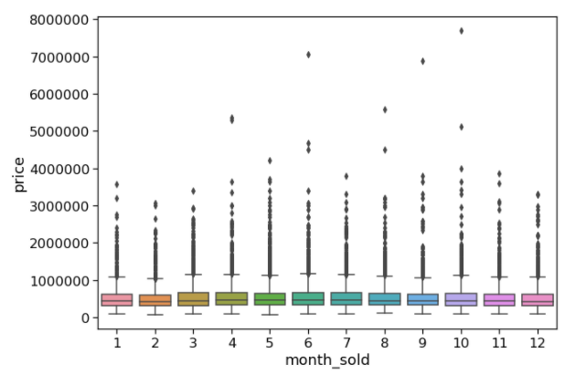
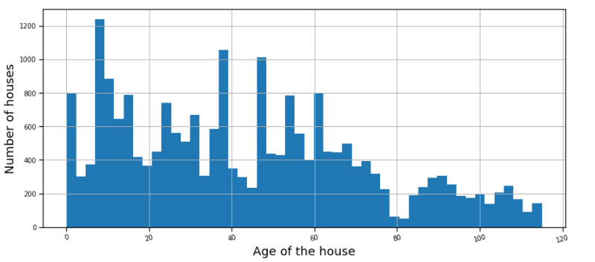
Few plots for Continuous Variables Features
Date(month wise) data distribution
Histogram showing number of houses in terms of their age
1-jan, 12-dec

Slide 14
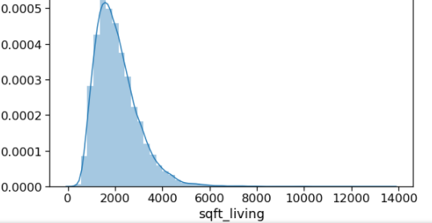
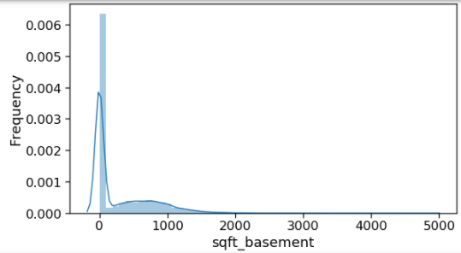
Plot showing distribution of area feature (sqft_living)
Plot showing distribution of area feature (sqft_basement)

Slide 15
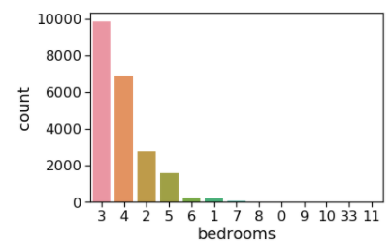
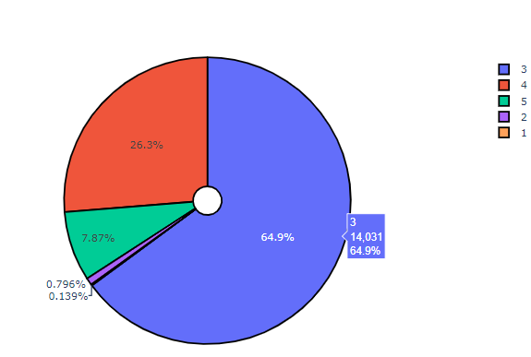
Plots showing distribution – Categorical Feature
While working with Categorical features, we plotted using Bar graphs and pie charts for better insights.
Number of bedrooms
Grade - pie plot

Slide 16
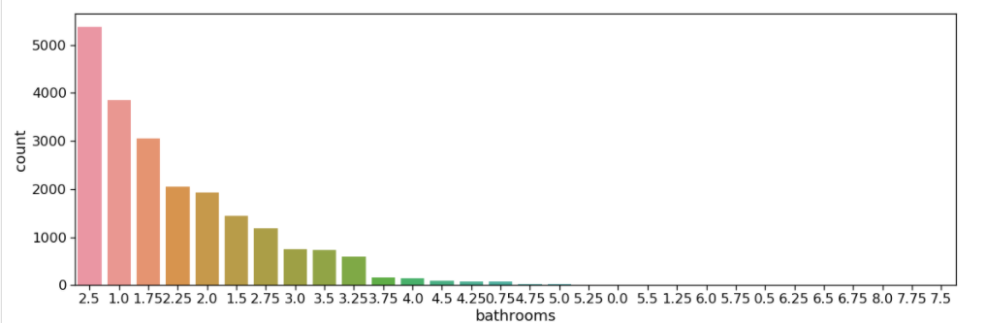
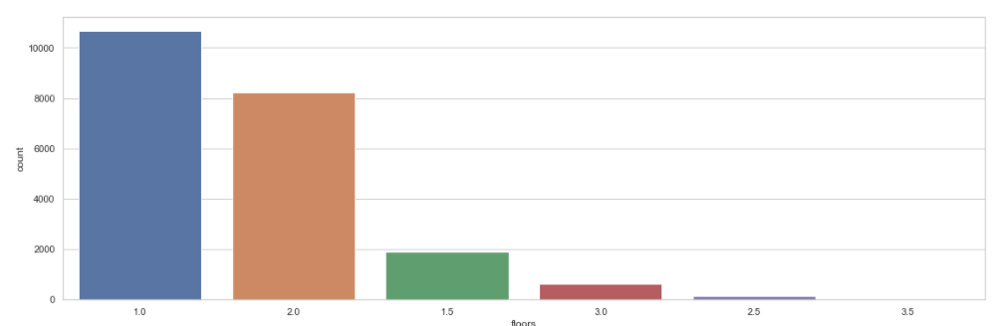
These columns were a bit different in categorical variable
No of Bathrooms –
.5 meant that had been attached to a bedroom and no shower
Floors –
.5 meant it is a Penthouse

Slide 17
Inference from Univariate Analysis
From our analysis on each continuous feature, main points that came out were:
Id variable(unique identifier) had few repeated values , and found out that some houses were sold multiple times.
Date variable when plotted, showed uneven distribution, so no house buying pattern.
For Living Area (sqft_living) we had right skewed plot under the area of 1000 and 4000 sqft.
Had some outliers around 10,000 sqft.
Similar were the inferences for other area features.
For latitude and longitude, we saw a pattern in latitude but for longitude.
Would look more into it further.
For age of the house, we had the maximum houses built in last 40 years.
Minimum and maximum ages were 0(same year) and 115 years(a vintage classic).

Slide 18
Inference from Univariate Analysis
From our analysis on each categorical feature, main points that came out were:
For Bathrooms column, we had unique values.
-- So how would these unique Values affect the prices ?
In Floors too we had penthouses and normal.
-- How would these affect sales?

Slide 19
Bivariate Analysis
Using the inference from Univariate analysis, we started working on the relational analysis between features and with the target variable.
Let’s divide our analysis from here into two parts:
Continuous –Continuous(Cont.-Cont.)
Categorical- Continuous(Cont.-Cat.)
While checking the correlations, we worked on to test our hypothesis and asked several questions to the data that we initially drafted.

Slide 20
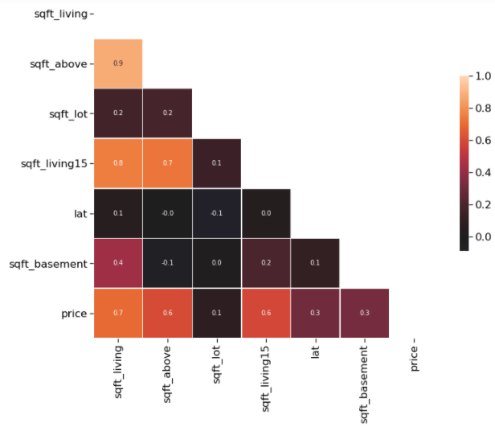
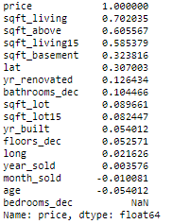
Cont.-Cont. Analysis
Let’s check correlation between numerical variables and then plot a heatmap:
Correlation value between different numerical features:

Slide 21
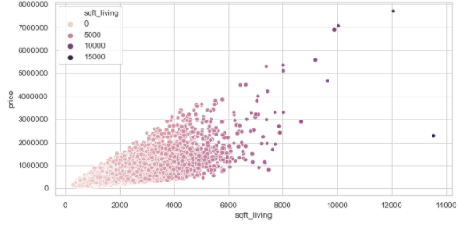
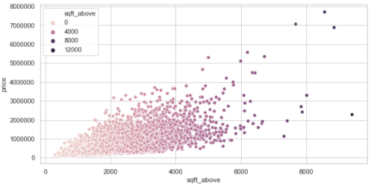
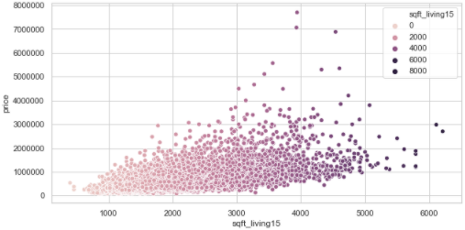
Area features to price
Sqft_living to price
Sqft_above to price
Sqft_living15 to price

Slide 22
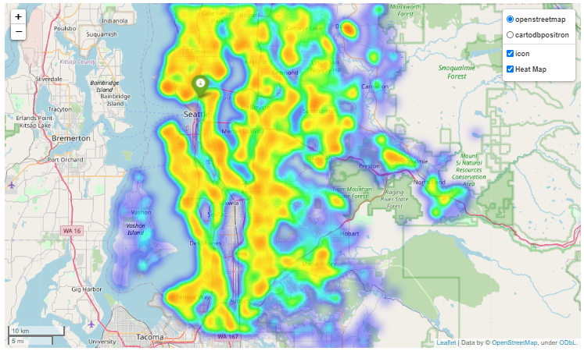
Plotting price wrt latitude and longitude
We further analysed the division of house dataset in four zone (by latitude and longitude)
Above breakdown showed that maximum houses are in South East region (taking mean(47.7, -122.3) as the central point)

Slide 23
Hypothesis and their outcome:
Were Prices always Increasing with the increase in area features.
-- Majorly Not all of them. But yes, They either had increasing linear relation or null effects on target variable
Were few points seen on Scatter plots of sqft_living and sqft_above outliers or a part of the trend?
-- On diving further and trying to find connection, they were Outliers and would be best to remove.
Price vary with the month (Do we have a pattern following the dates?)
No impact because of the period at which the house was bought (year or month).

Slide 24
Inference from cont.-cont. feature analysis:
Analysis implies that we had high correlation between:
Sqft_living (The Flats area available) and price
Sqft_above (Interior spce above ground) and price
Sqft_basement (Basement Area) and price
Sqft_living15 (Nearest 15 houses Area) and price
sqft_living and sqft_living15
Our analysis also give us some interesting information as :
yr_built, yr_renovated, also show high correlation with price
Latitude had positive correlation to the sales price.

Slide 25
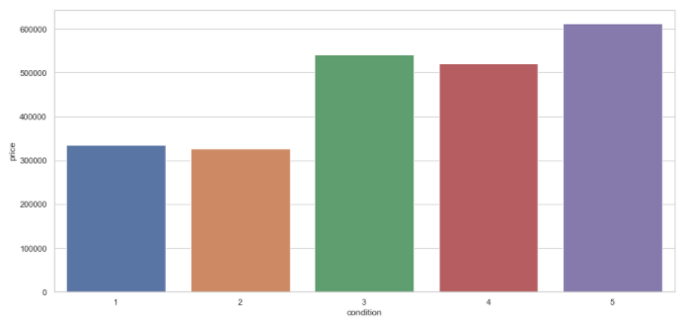
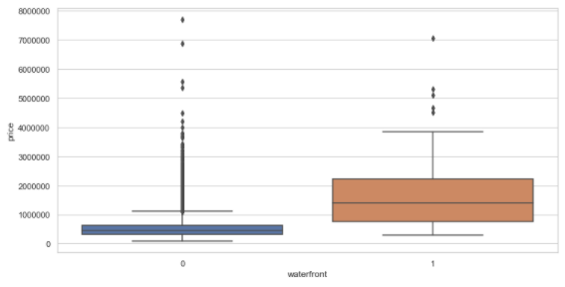
Cont.-Cat. Analysis
Waterfront to price
Condition and price
Does having a waterfront increase sale price?
Yes, we can infer the increase from plot below
Does house with good condition attract more price tag?
It is clearly visible that higher the Condition rating, more the price of the house

Slide 26
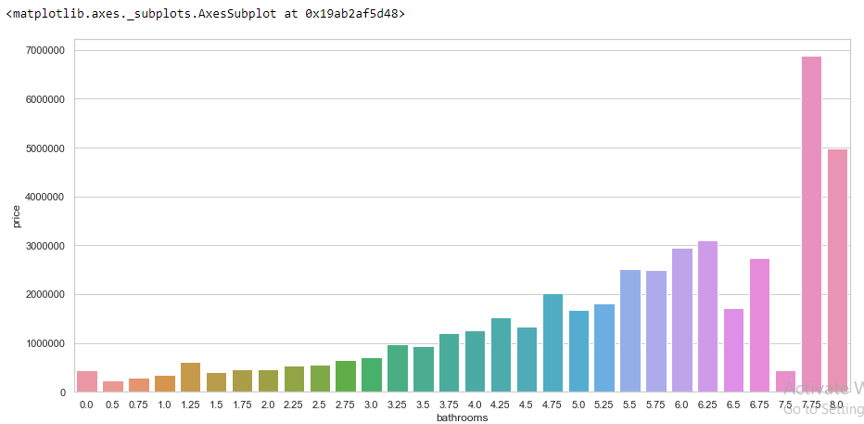
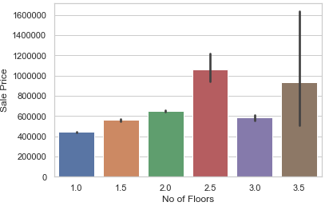
Cont.-Cat. Analysis
Would Having luxury Bathrooms increase prices in unusual ways?
They are high for luxury but linearly wrt Number of bathrooms
Were No of Floors Increasing the House prices unusally?
-- No, they were just high with increased luxuries and numbered floors.

Slide 27
Some Hypothesis after looking at the Bivariate analysis results
--Were the sudden changes in prices due to No of Floors at number 3 significant enough?
-- Null hypothesis – Were the change in Floor sale prices at 3 Significant enough ?
Were the Price change due to Condition at 4 Significant ?
--- Null hypothesis – Were the Changes at the condition 4 significant ?
-- This would require T and Z test to be performed!
-

Slide 28
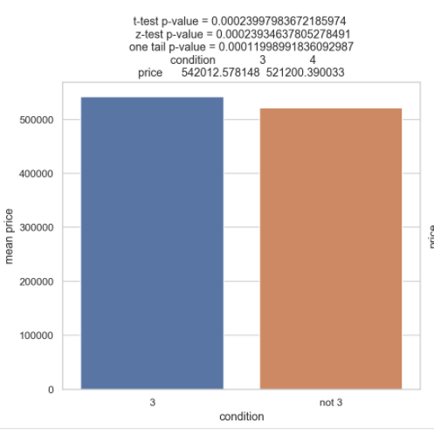
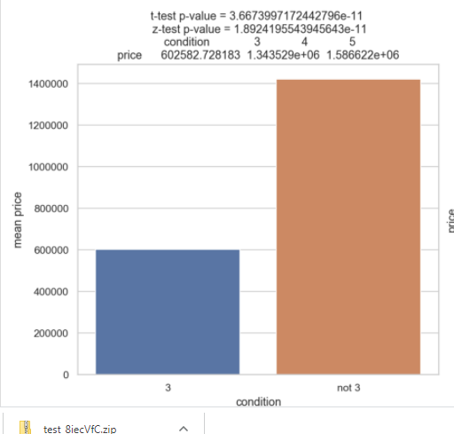
Hypothesis testing:
We rejected our null hypothesis for both condition and floor of the house.
Since we got very less p value as compared to the alpha

Slide 29
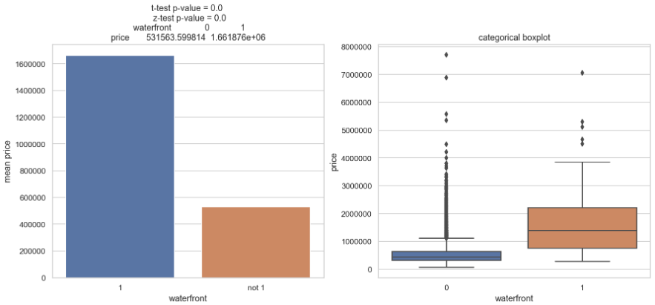
Hypothesis testing
Is the price of house with waterfront similar to any other house?
We rejected our null hypothesis for both condition and floor of the house.
Since we got very less p value as compared to the alpha

Slide 30
Hypothesis and their outcome:
Does house with good condition attract more price tag?
--Linearly increasing,.
Did Overall Grade increase Sale prices?
-- Yes.
Were No of Bathrooms and Bedrooms affecting the Prices Effectively
-- Again , yes. And linearly increasing
Would Zipcode also affect the prices ?
-- No they weren’t changing the prices.

Slide 31
The features (out of 24) for model running.
Continuous Features
Sqft_living
Sqft_above
Sqft_living15
Sqft_basement
Categorical Features
Floors
Condition
Grade
Bedrooms
Bathrooms
Age of House

Slide 32
Feature consideration for Mean Model
The Mean model was made using RMSLE since it was for a broker who wanted to sell houses further.
The errors were compared for indiviual columns first and likewise for two features and then with all the features.

Slide 34




Calculating rmsle value for different categories
rmsle value for condition:
Rmsle value for view:
Rmsle value for grade:
Rmsle value for floor:

Slide 35




Calculating rmsle value for different categories
Rmsle value for bedrooms:
Rmsle value for bathrooms:
Rmsle value for sqft_living:
Rmsle value for sqft_basement:

Slide 36
The features we selected from our analysis are:
Continuous Features
Sqft_living
Sqft_above
Sqft_living15
Sqft_basement
Categorical Features
View
Condition
Grade
Bedrooms
Floor
Bathrooms

Slide 37
Thank You

